Slide 1
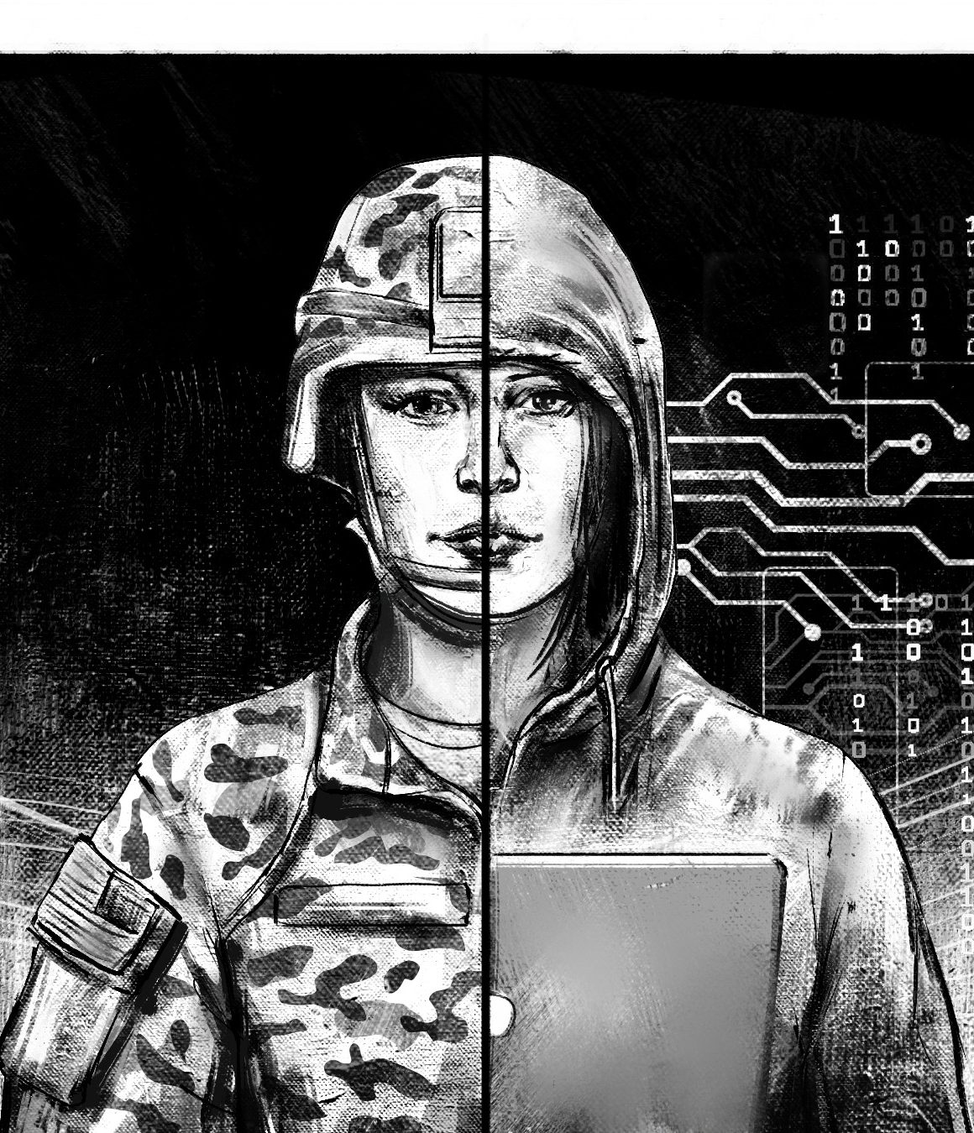
AI in Warfare
Christian, Linus, markus, Adrian
Abdullah, Eesha, Haider
Notes:
Short introduction
Ai starts being more prominent in every area of our daily life
But how will it shape the future in the area that is perhaps the most dangerous and delicate of all?
Today we will talk about views and takes on the usage of AI in Warfare

Slide 2
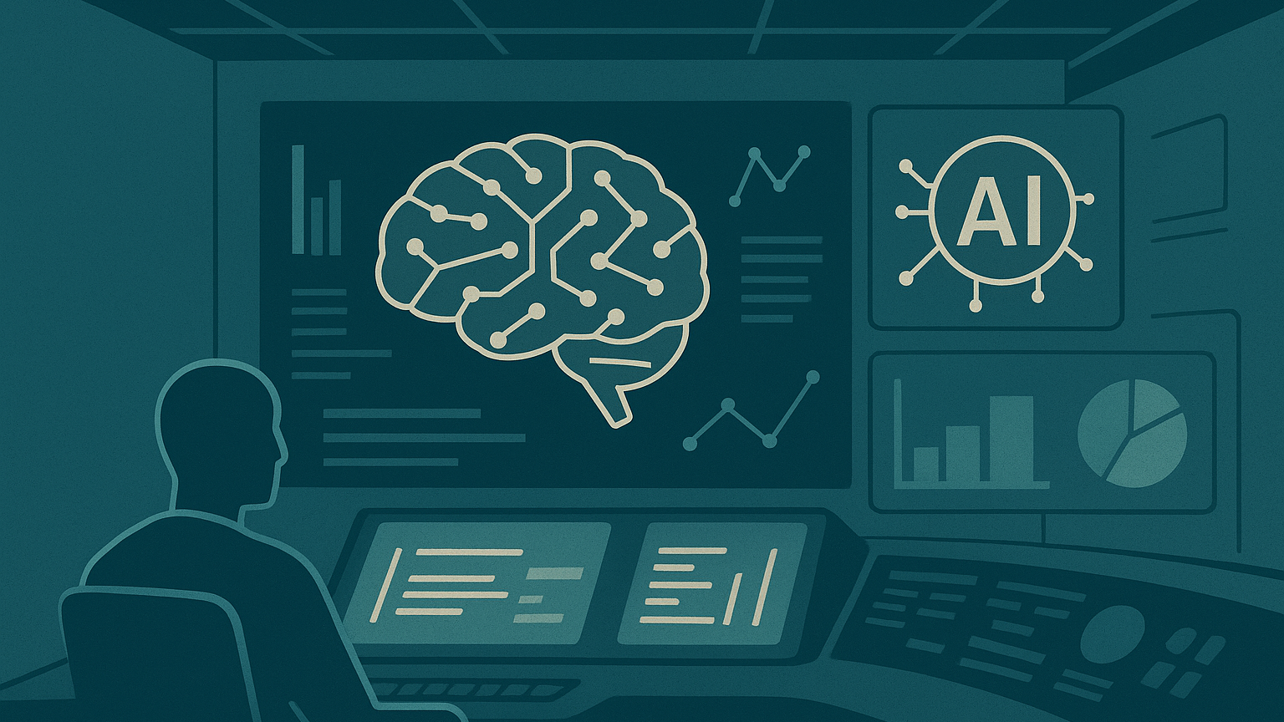
Opportunities
Notes:
- computing large amounts of data quickly
- perform human tasks without deploying personell
- optimize procedures
- helping monitor and secure borders

Slide 3
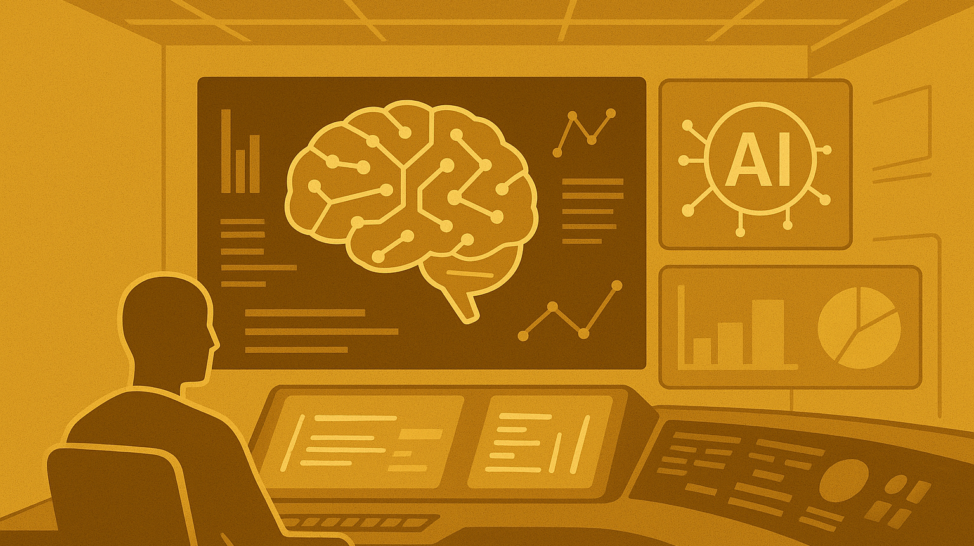
Risks
Notes:
- Vulnerable to Cyberattacks and manipulation
- limited computing on field, if used in vehicles
- depends strongly on infrastructure outside of vehicles
- Deepfakes and impersonation

Slide 4
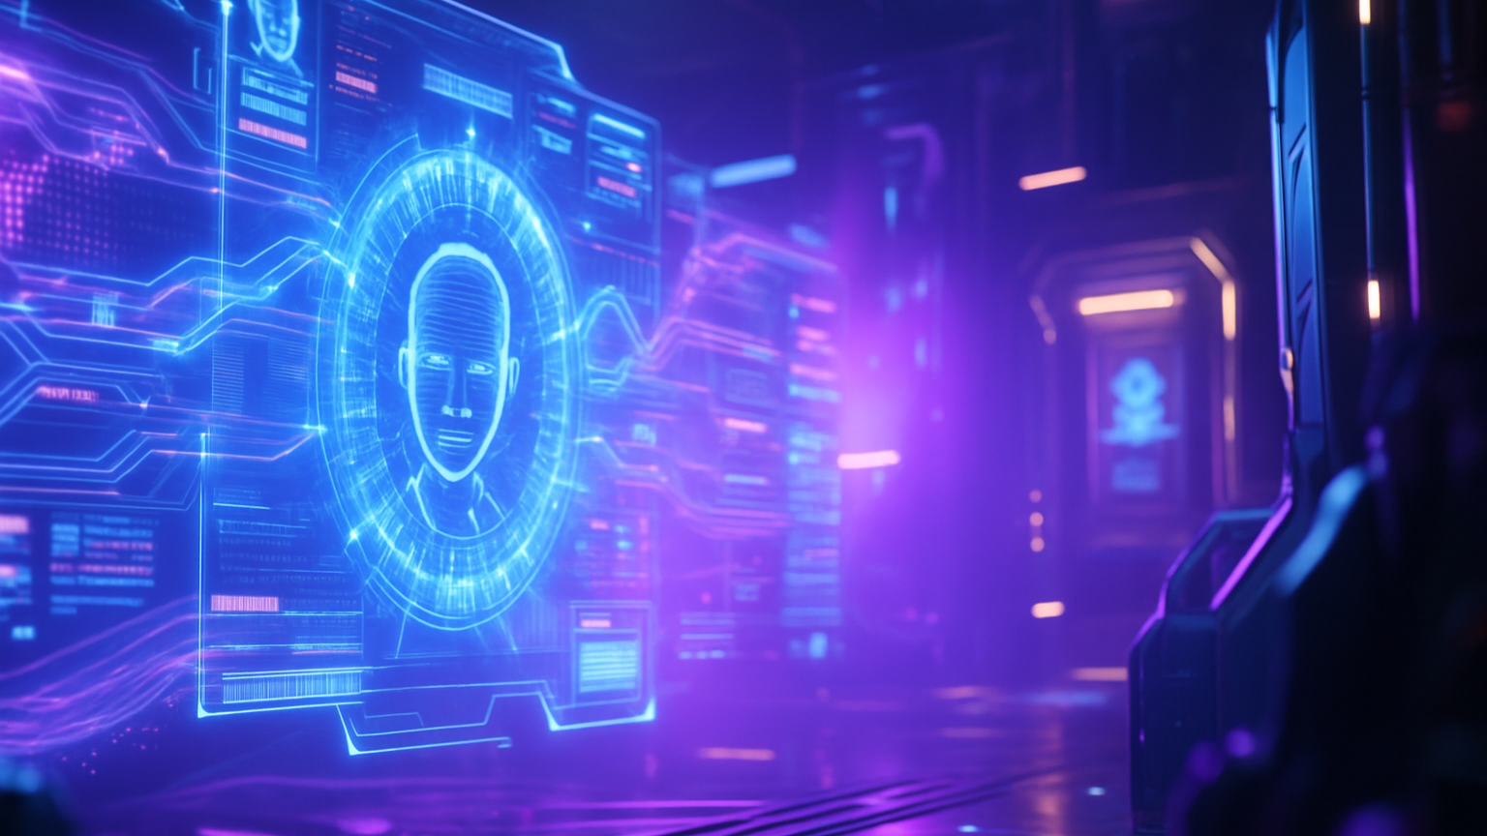
Perspectives
Germany
Notes:
Germany
- Is currently being researched in a specialized AI-Laboratory
- Partially used in Tanks and Anti-Aircraft Emplacements
- may be used determining optimal routes for cars and planes

Slide 5

Perspectives
PAKISTAN
Notes:
Pakistan
- may be used in border security and counter terrorism
- may be help detect propaganda, extremist content and cyber threats
- Danger comes from non-state actors implementing AI, even if they are not very developed yet
- Already used for propaganda and in drones for surveillance and small-scale attacks

Slide 6
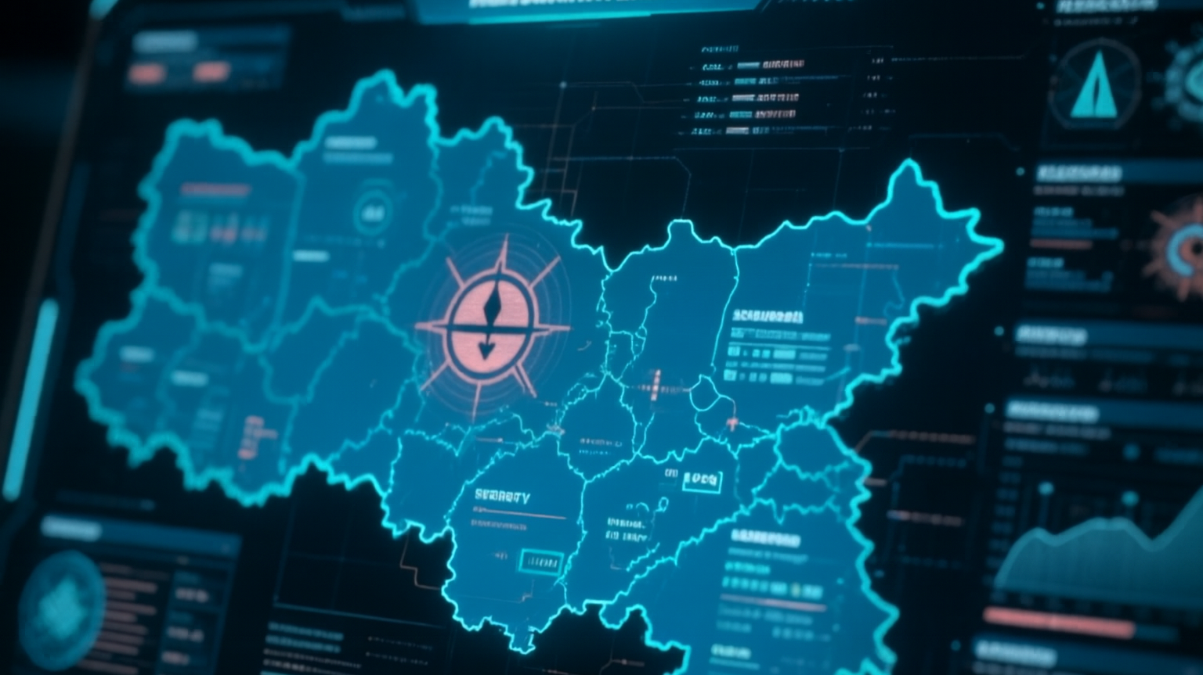
Imaginary Scenario
Notes:
- Two Countries at war
- apart from physical fighting, the fight is also fought online
- Deepfakes and impersonations through AI created by both countries aim to destabilize the other
- there are cyberattacks all the time, aiming for data used by AI and the AIs themselfes, trying to infilitrate and manipulate the enemy
- Every bit of information is used against the other, even dragging citizens into it
- All fueled by AI unleashed in the Internet, enabling this kind of involvement
- Information turns into the most valuable ressource and the strongest weapon, and the battlefield is everywhere

Slide 7
Citations and used tools
https://www.bundeswehr.de/de/organisation/cyber-und-informationsraum/aktuelles/kuenstliche-intelligenz-5960274
https://www.kas.de/documents/252038/22161843/Zukunft+der+Bundeswehr+KI.pdf/72168435-741f-a612-2389-74c7655fd55b?version=1.0&t=1673949515294
https://gnet-research.org/2025/06/18/nascent-adoption-emerging-tech-trends-by-terrorists-in-afghanistan-and-pakistan
https://tnsr.org/wp-content/uploads/2025/07/Lonergan-and-Snyder.jpg
ChatGPT
DeepAI
CapCutAI

